Slide 1



Preparing Athletes for Competition?
A guide to help athletes to perform at their best!

Slide 2
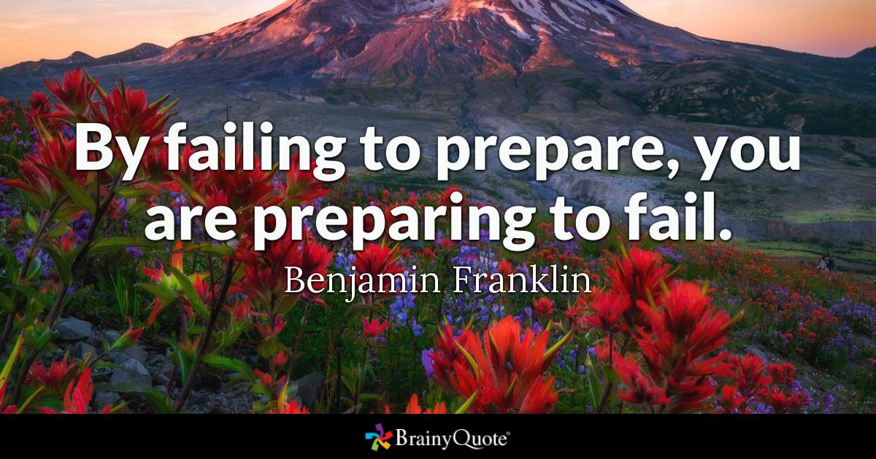
When does the Competition start?

Slide 3
The day before the Competition:
Factors you can influence the day before the Competition
Nutritional Status – Make good nutritional choices the day before the competition
Hydration Status - Ensure you are properly hydrated before the competition
Competition Awareness – Setting the Scene
Race Strategy – When am I racing?
Amount of Recovery & Rest – Stretching / Rolling / Sleep
Importance of the last training session – Fine tuning & race rehersal
Pack Racing Bag – All equipment you need for the competition & spares!
Provide an opportunity to relax
Get work/homework done – Remove external pressures away from the competition
Create your own Pre-Competition Plan!

Slide 4
Competition Timeline
Having a Competition Timeline can provide clarity on the preparation for your race!
“Those athletes that follow a timeline end up having the best results”
Each Competition Timeline is individual to that athlete and can be personalised to their specific needs.
This then allows the swimmer to take ownership of their process around the competition.

Slide 5
Example: Competition Day Timeline
Breakfast
Race – 180 minutes
Arrive at Venue
Race – 150 minutes
Self Check & Mobility
Race – 120 minutes
Activation Work
Race – 90 minutes
Pool Warm Up
Race – 75 minutes
Pre-Race Activation
Race – 15-20 minutes
Race
Race – 0 minutes

Slide 6
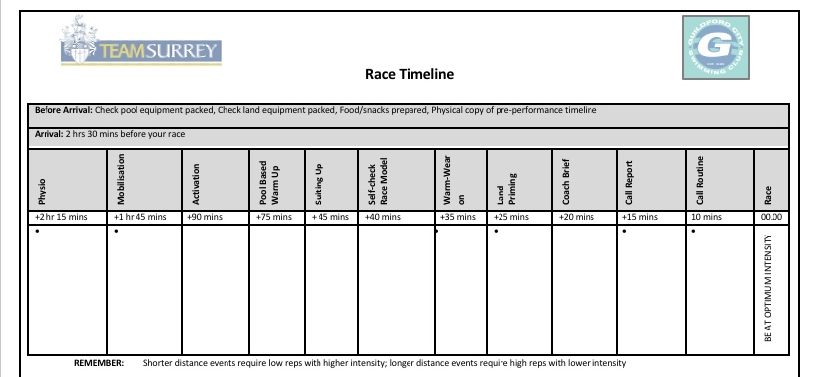

Slide 7
Competition Timelines: Summary
Speak to your Coach regarding the club designated competitions
Remember your timeline will grow and evolve with you!
Have fun following the process of executing your timeline!
Once you have submitted your entries for the selected competition, create your own personal timeline.
Check and agree your timeline with your coach

Slide 8
Tackling Motivation
1. Types of Motivation
2. Role of Coaches in Motivating Swimmers
3. Swimmers Motivation Themselves
4. What is the healthy balance?

Slide 9
1. Types of Motivation
What is Motivation?
“Enthusiasm for doing something or the need or reason for doing something” Cambridge English Dictionary Definition
2 Different Types of Motivation:
Intrinsic Motivation: “Behaviour driven by internal rewards” (Enjoyment, personal satisfaction, learning opportunity, happiness)
Extrinsic Motivation: “Behaviour that is driven by external rewards” (Money, gifts, fame, praise)

Slide 10
2. Role of Coaches in Motivating Swimmers
To inspire the athletes on a day to day basis.
To provide swimmers with skills for life
Make swimming training and competition enjoyable for the athlete
To write sessions that are mentally and physically stimulating for the swimmers
To educate and challenge the swimmers to maximise their potential.
Provide a safe space for athletes to express themselves

Slide 11
3. Swimmers Motivating Themselves
The top performers in all sports are highly intrinsically motivated and are always striving for perfection – Their perfect race!
Swimmers need to understand their “Why?”
Why do you swim? What is it about swimming that you love?
Completing Goal Setting on a regular basis is a great way of staying motivated:
Short Term Goals – Daily / Weekly Goals?
Medium Term Goals – Monthly / Cycle?
Long Term Goals – Yearly / Olympic Cycle

Slide 12
4. The healthy balance?
Swimmers should be intrinsically motivated with support and guidance from their network of coaches, family and friends.
Athletes who are more intrinsically driven will achieve at a higher level and stay in the sport longer.
Intrinsic motivation can be created by the athlete taking ownership or accountability for their actions. Where the athlete has to look inwards for motivation to overcome a challenge/challenges.
Coaches should be supportive and manage expectations of athletes to sustain enjoyment in the sport.

Slide 13
Thank you all for listening! Any Questions?

